Slide 1

AML-2304 Natural Language Processing
Lambton College
School of Computer Studies
[Prepared By: Vahid Hadavi, PhD]

Slide 2
Module 9 9. Demonstrate Files operations in Python
Major Topics:
9.1 Illustrate reading and writing to Text files
9.2 Show reading and to PDF files
9.3 Show merging of PDF files

Slide 3
9.1 Illustrate reading and writing to Text files

Slide 4
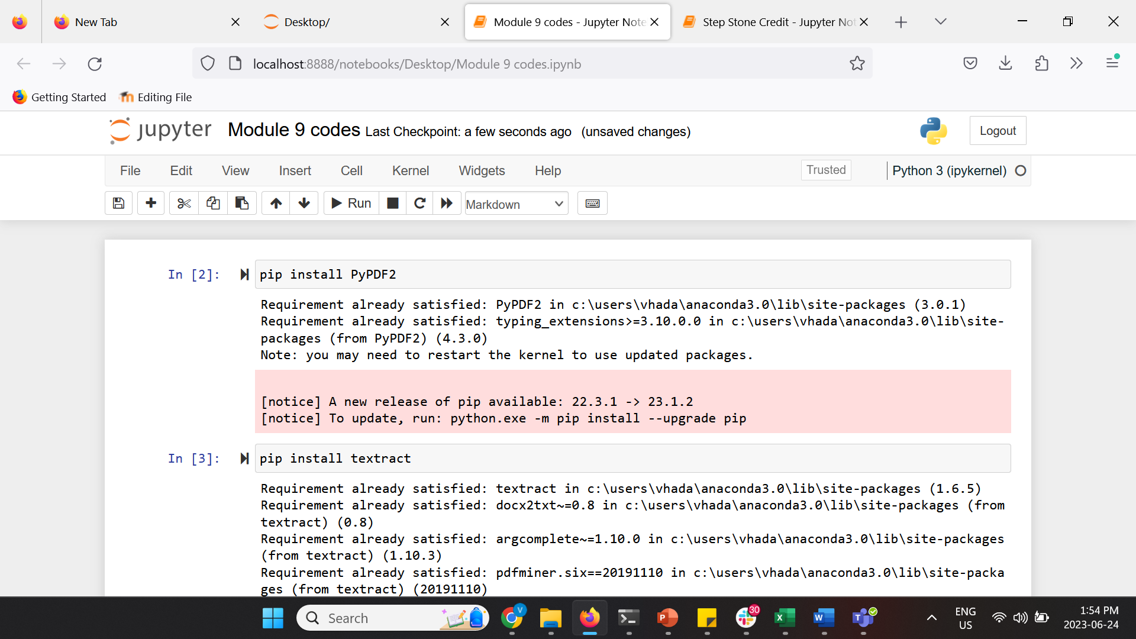
Reading PDF files
We may need to use texts from PDF files.
Since PDF is a proprietary format provided from Adobe, it is not easy to extract text from it.
We will be using “news” corpus to demonstrate the performance of the classifiers.
There are several packages available on python that can help us to do this task:
PyPDF2- to convert simple PDF files into text readable by Python
textract- To convert non-trivial, scanned PDF files into text readable by Python
These packages need to be installed using pip.
These packages are used with NLTK to handle PDF files.
Use the following link to download the file to complete the exercises in this parts of the course : Lorem_ipsum.pdf
https://www.buds.com.ua/images/Lorem_ipsum.pdf

Slide 5
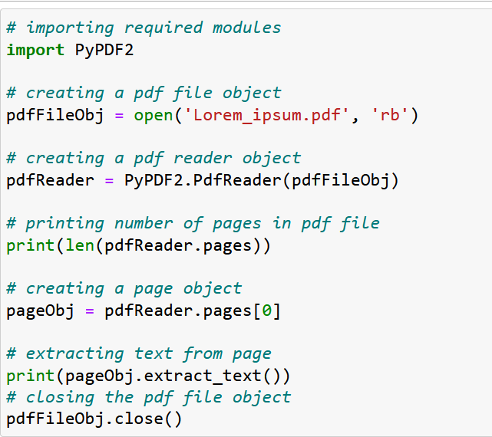
Reading PDF files

Slide 6
Reading PDF files
Let us try to understand the above code in chunks:
pdfFileObj = open('Lorem_ipsum.pdf', 'rb’) : We opened the example.pdf in binary mode .And saved the file object as pdfFileObj
pdfReader = PyPDF2.PdfReader(pdfFileObj) : Here, we create an object of PdfFileReader class of PyPDF2 module and pass the PDF file object & get a PDF reader object
print(len(pdfReader.pages)) : numPages property gives the number of pages in the PDF file. For example, in our case, it is 20 (see first line of output)
pageObj = pdfReader.pages[0] : Now, we create an object of PageObject class of PyPDF2 module. PDF reader object has function getPage() which takes page number (starting from index 0) as argument and returns the page object.
print(pageObj.extract_text()) : Page object has function extractText() to extract text from the PDF page.
pdfFileObj.close() : At last, we close the PDF file object.

Slide 7
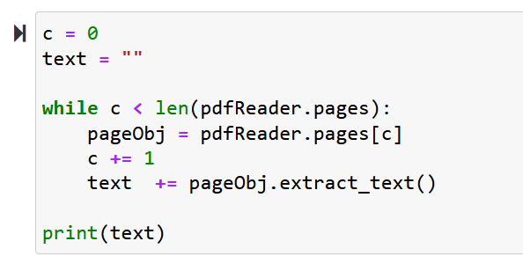
Reading PDF files
Challenge question : write a more efficient code to print the data on the first line of text on page #1

Slide 8
Reading scanned PDF files
To read scanned pdf files process() function on textract can be used.
There are different methods available to extract the text.
They need to be separately installed using pip.

Slide 9
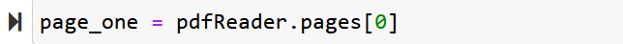


Writing to PDF files
We can write some text to a PDF file using PyPDF2 package.
We will be writing the content of the PDF file we read into a new PDF file.
First, we get the first page of the PDF file we read using PyPDF2 and make a new variable as “page_one”.
Then we create an object to use it to write to a PDF document.
Next, we add a page (page_one) to the object we have created.

Slide 10
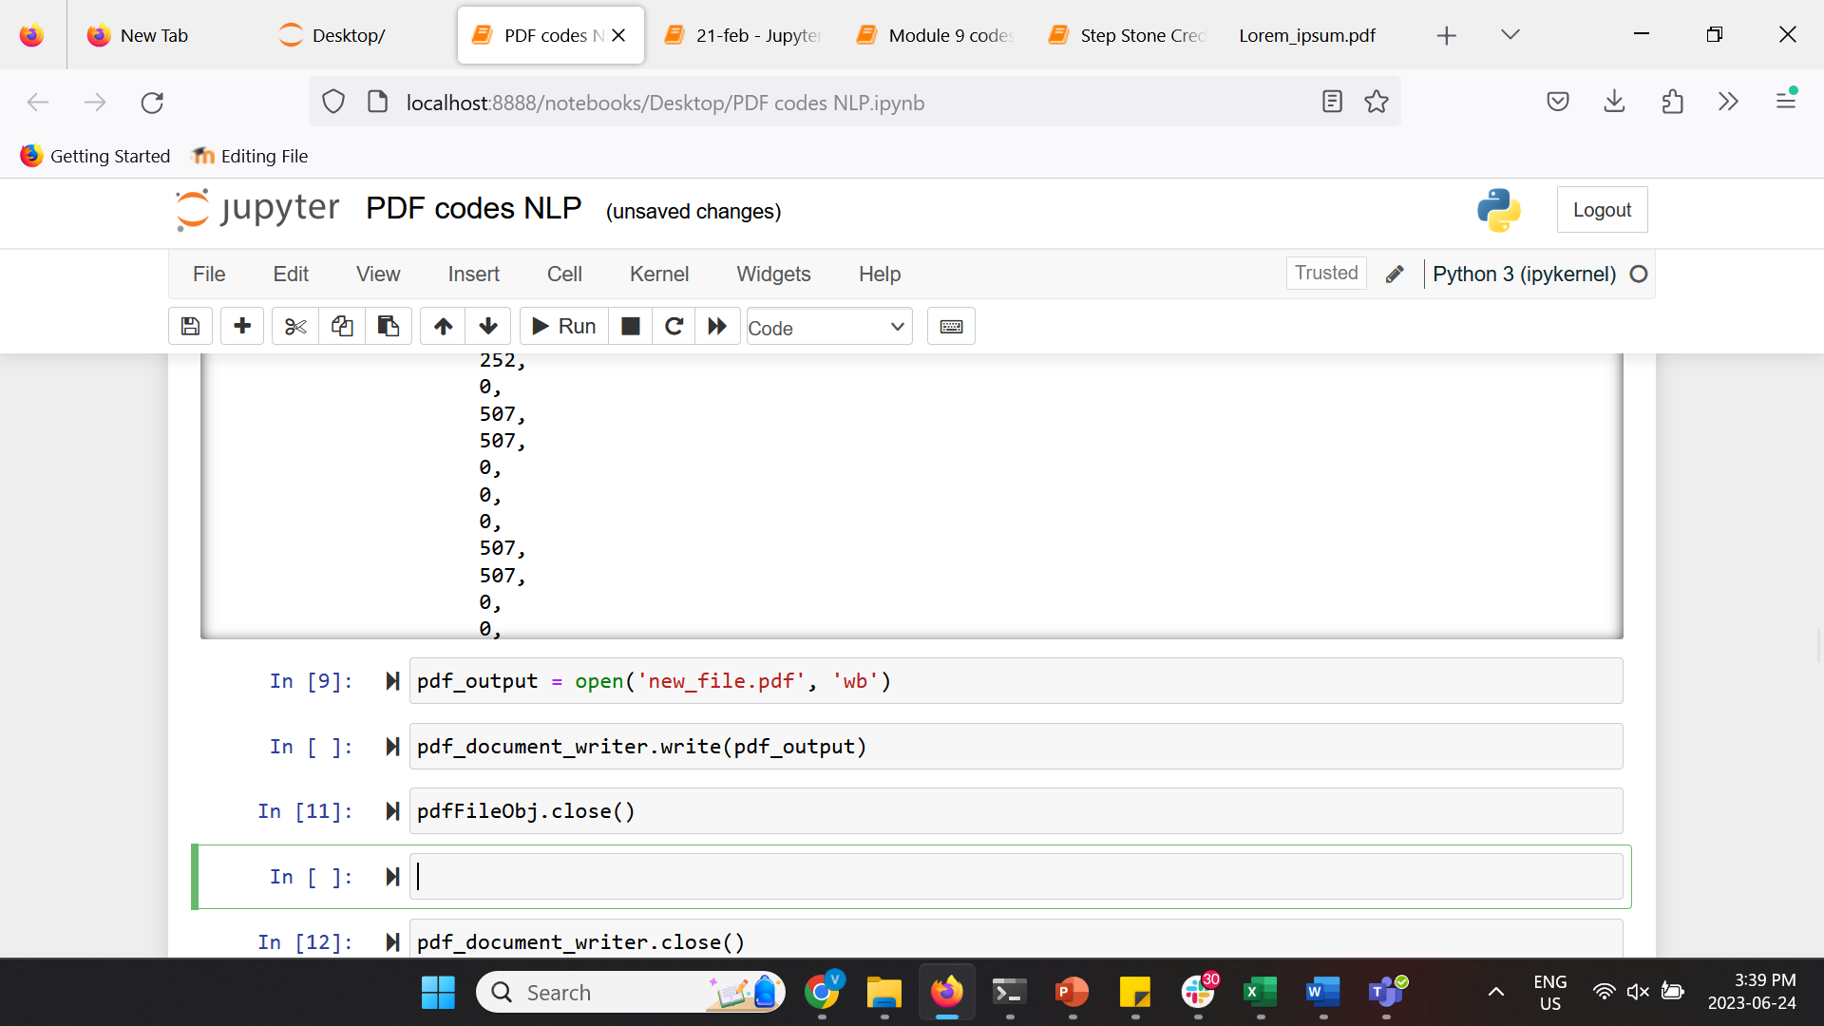
Writing to PDF files
Next, we open a new PDF file.
Lastly, we use write() method from our created writing object to write to the new PDF file.
Check the created PDF files on your root directory and see the content? Discuss your observations with your classmates.

Slide 11
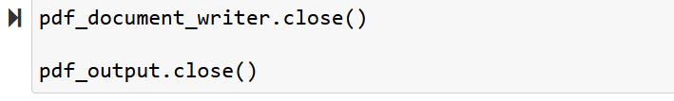
Writing to PDF files
Now, let’s run the following code

Slide 12
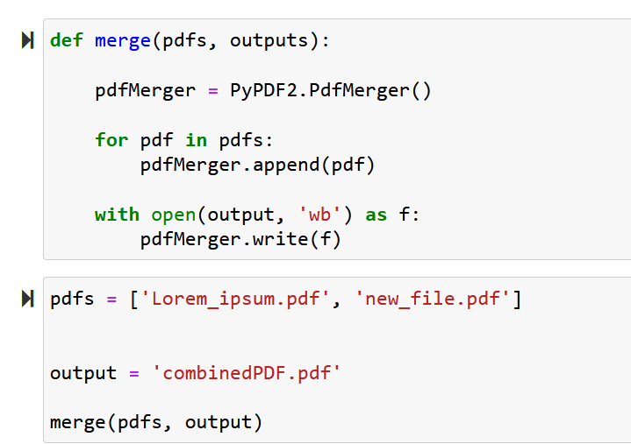
Merger of PDFs
Next, we merge two PDF files to a new PDF file.

Slide 13
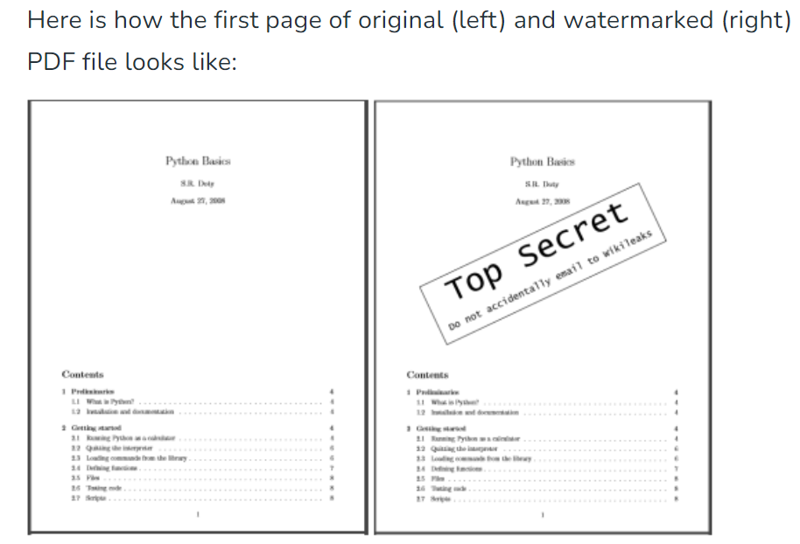
Challenge Questions
1- Split the ‘combinedPDF.pdf’ file into two files called ‘File1.pdf’ and ‘File2.pdf’
2- Rotate ‘File1.pdf’ for 180 degrees and save it to a new file called ‘File3.pdf’
3- Add a watermark to the first page of ‘File3.pdf’ and save it as ‘File4.pdf
(Here is an example of watermark on a typical pdf file)

Slide 14
Any questions so far? Any comments?

